Slide 1
AI based motion control detail algorithm presented in formula
2.4 Jin Lexuan

Slide 2
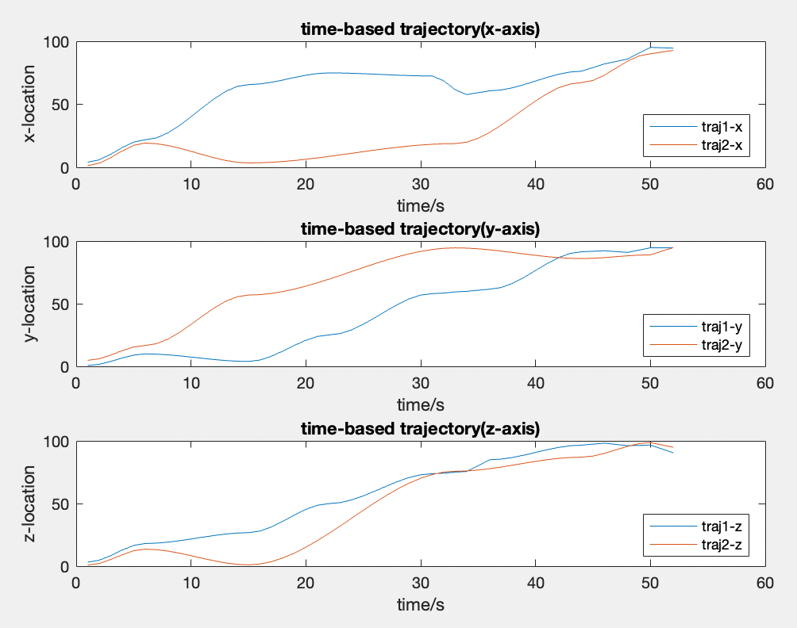

Tajectory(Position of each second)
From two trajectory, we can calculate the distance of UAVs for each second, if the distance is smaller than the collision threshold, it will be detected and the time will be recorded.
In this example, collision will happen in
From left image, it shows at 48s,49s,52s, two UAVs are very close to each other.
colnum shows how many collision will happen

Slide 3
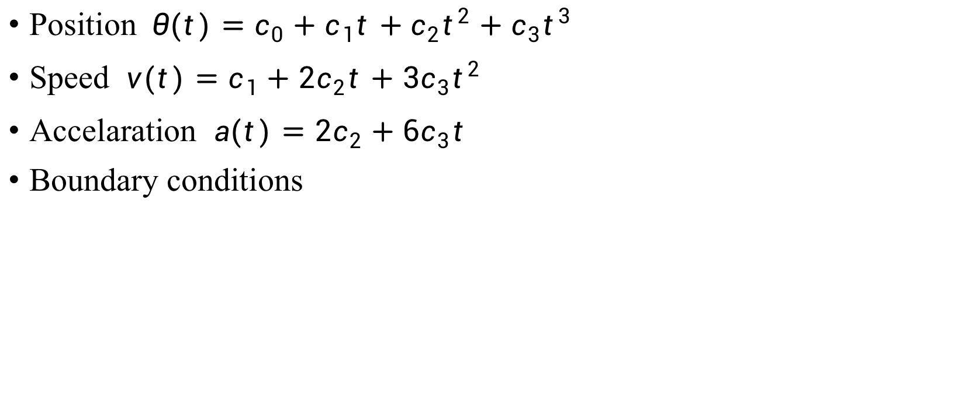
Transfer path to trajectory
Position $θ(t)=c_{0}+c_{1}t+c_{2}t^{2}+c_{3}t^{3}$
Speed $v(t)=c_{1}+{2c}_{2}t+3c_{3}t^{2}$
Accelaration $a(t)=2c_{2}+6c_{3}t$
Boundary conditions
derivation
 | Position | Velocity
t=0 | a | 0
t=T | b | 0

Slide 4
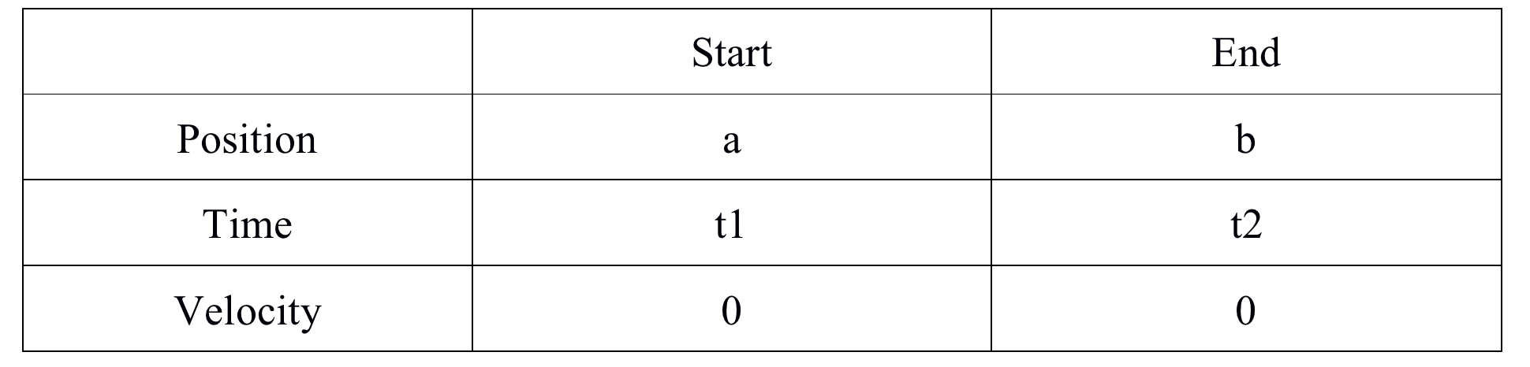
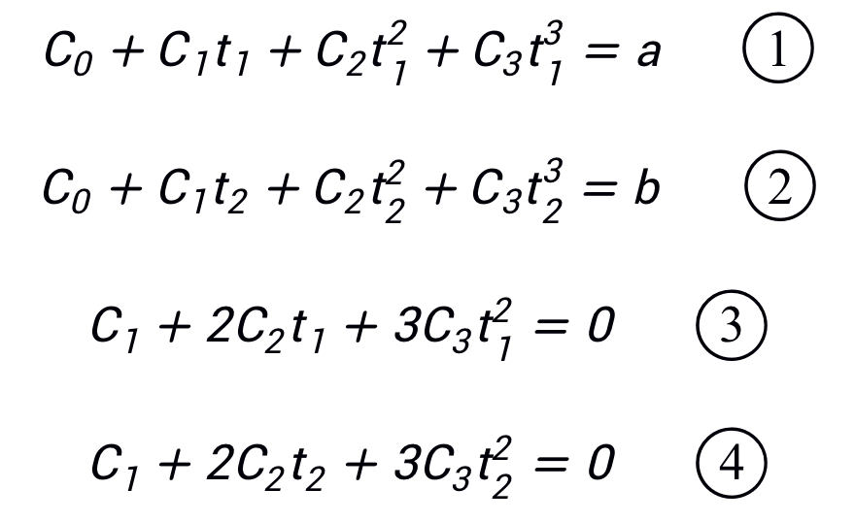
Given conditions
a, b, t1, t2 are known

Slide 5
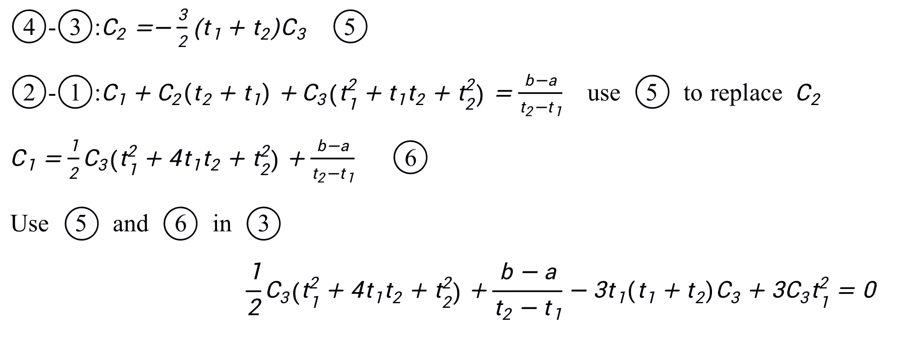
Solve the equation

Slide 6
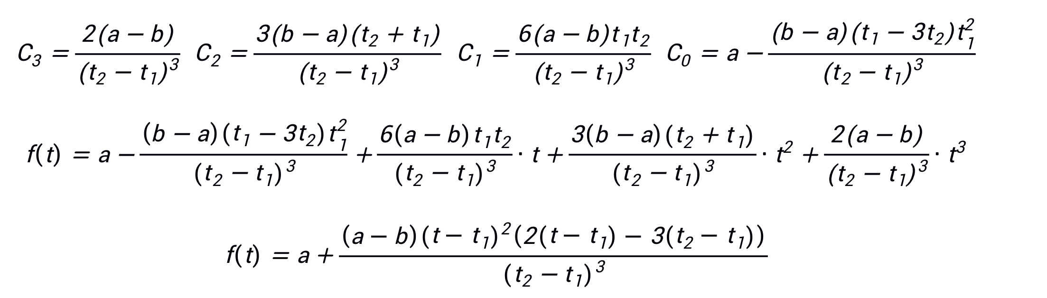
solution：
assume collision happens at tc and t1<tc<t2
to slow down the trajectory, increase time period (t1, t2) by tc-t1, new t2→t2+tc-t1 to speed up the trajectory, decrease time period (t1, t2) by t2-tc, new t2→tc

Slide 7
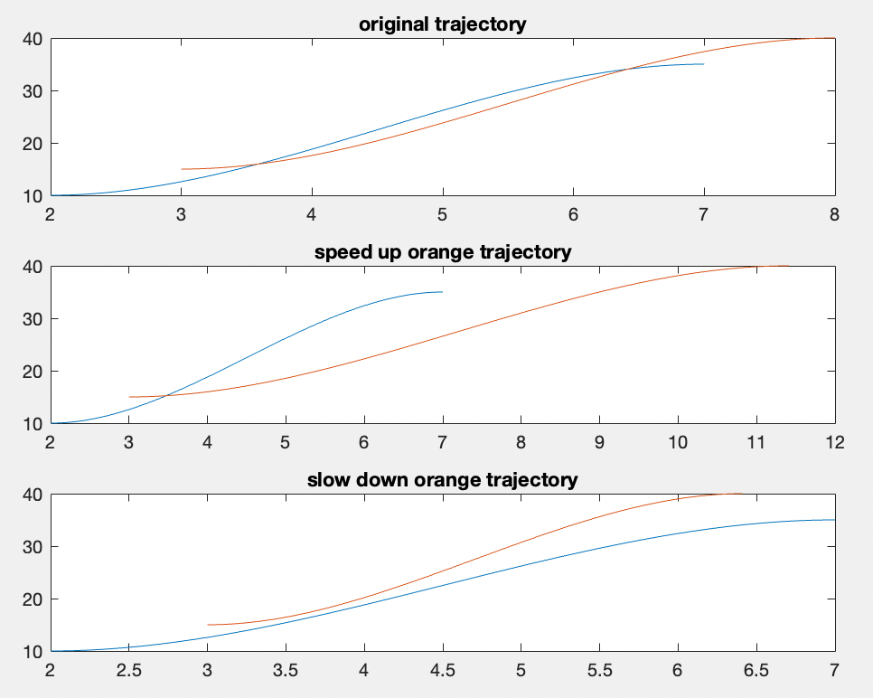
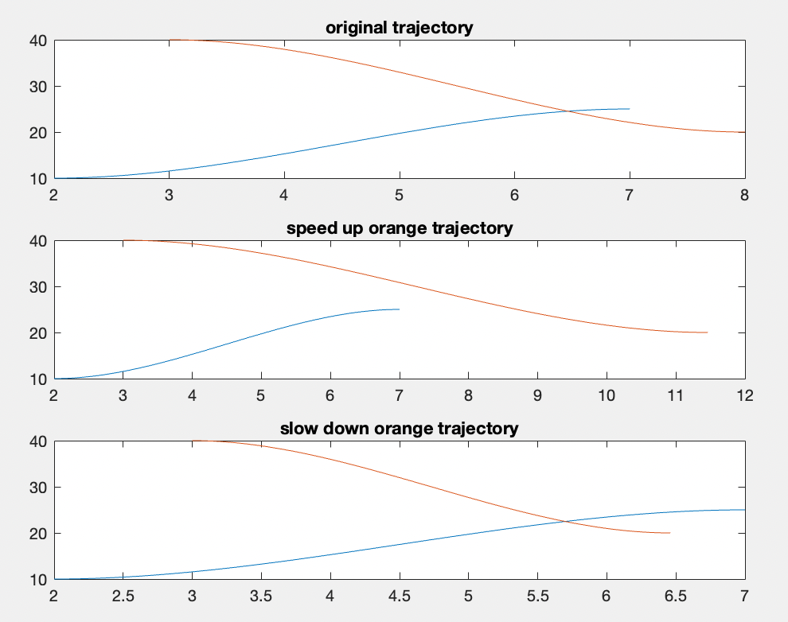
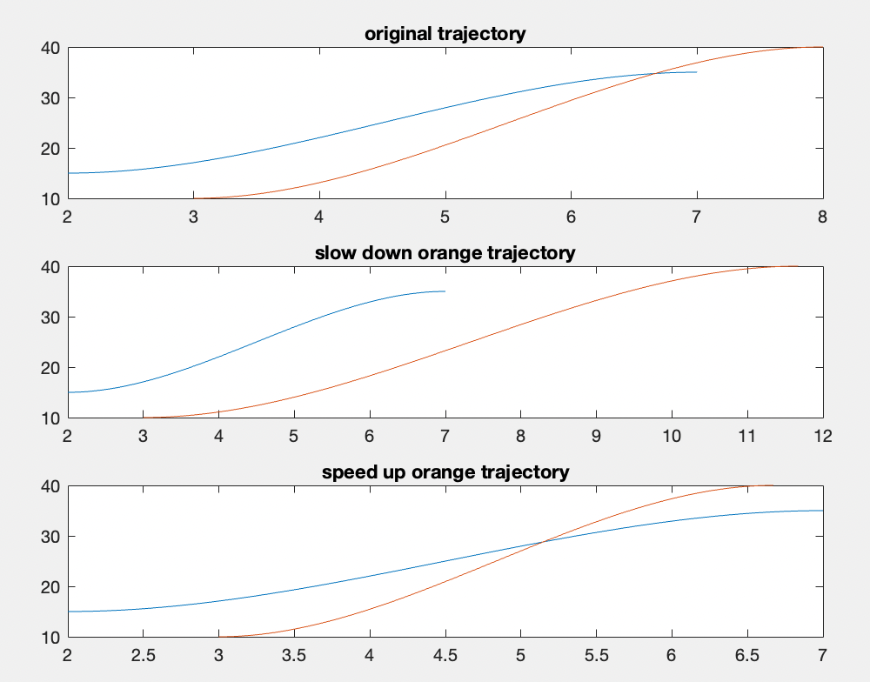
some examples
to slow down the trajectory, increase time period (t1, t2) by tc-t1,
new t2→t2+tc-t1
to speed up the trajectory, decrease time period (t1, t2) by t2-tc,
new t2→tc

Slide 8
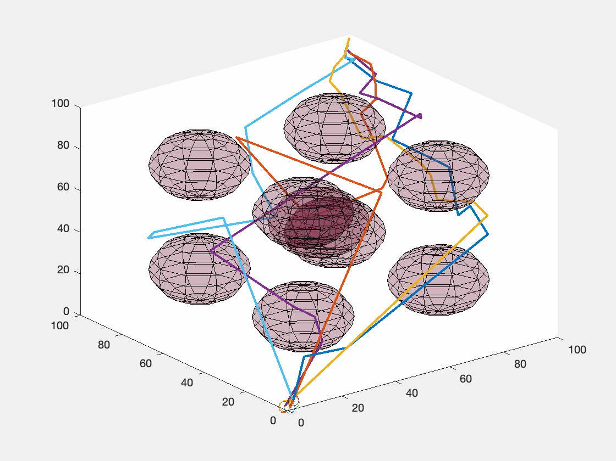
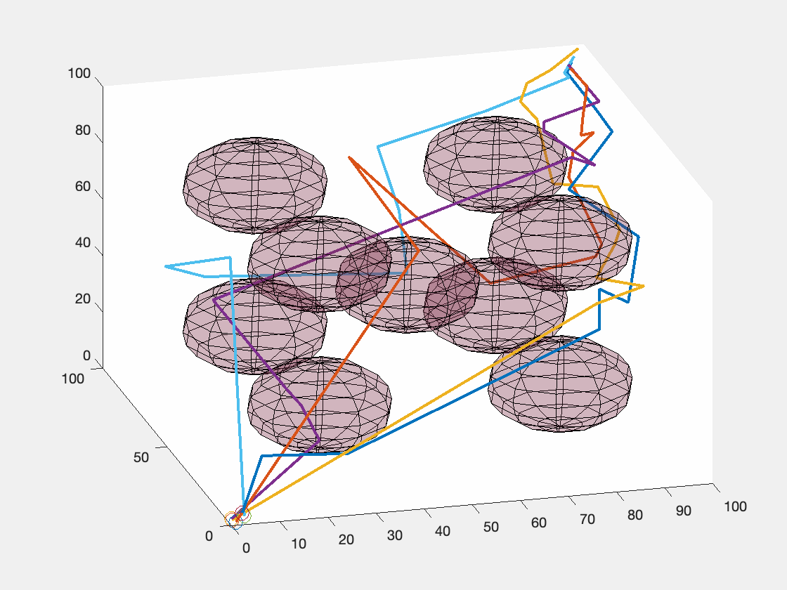
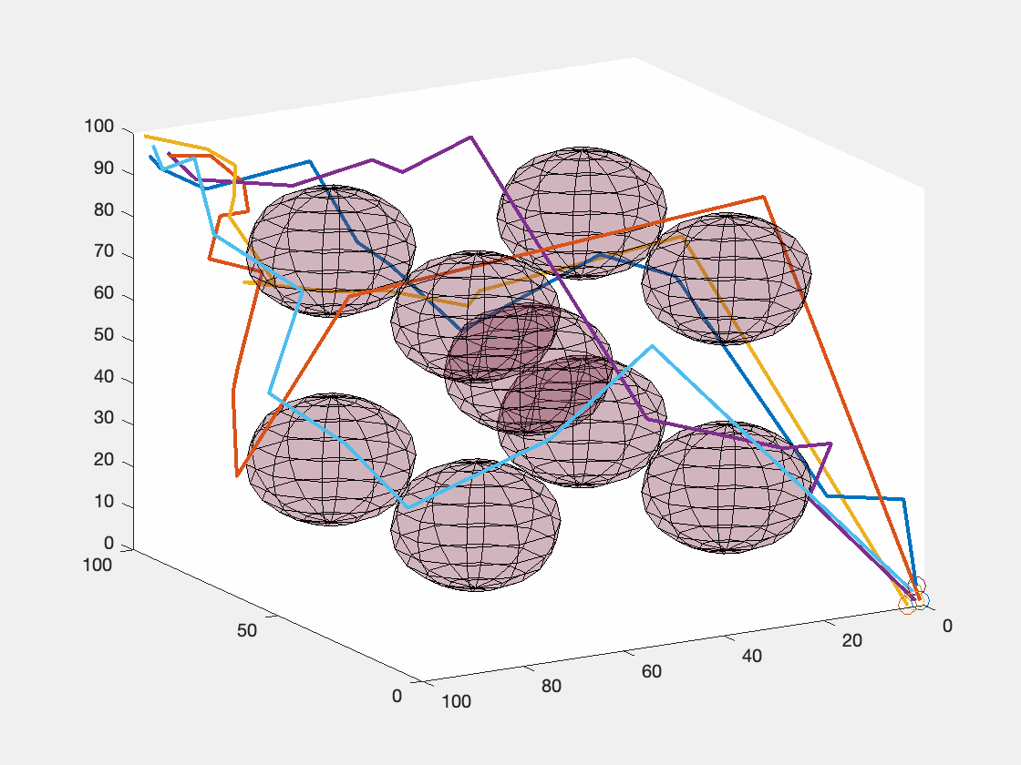
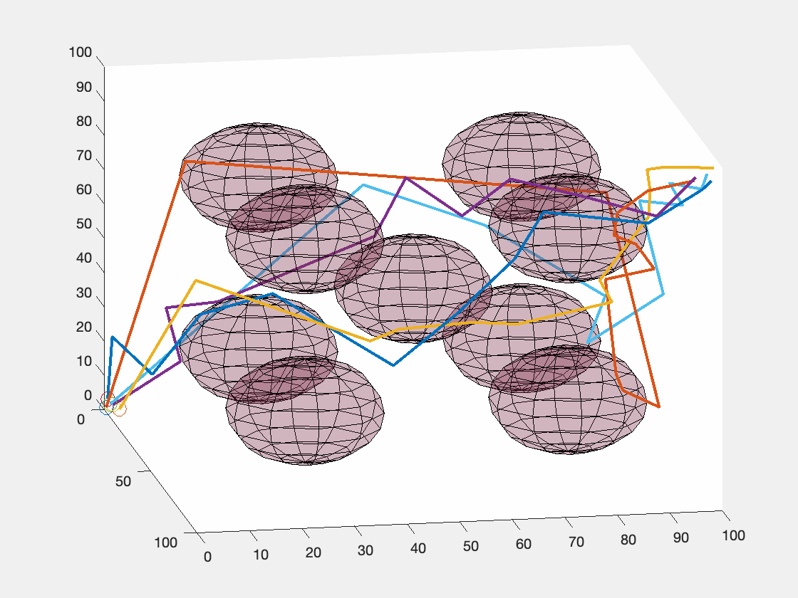
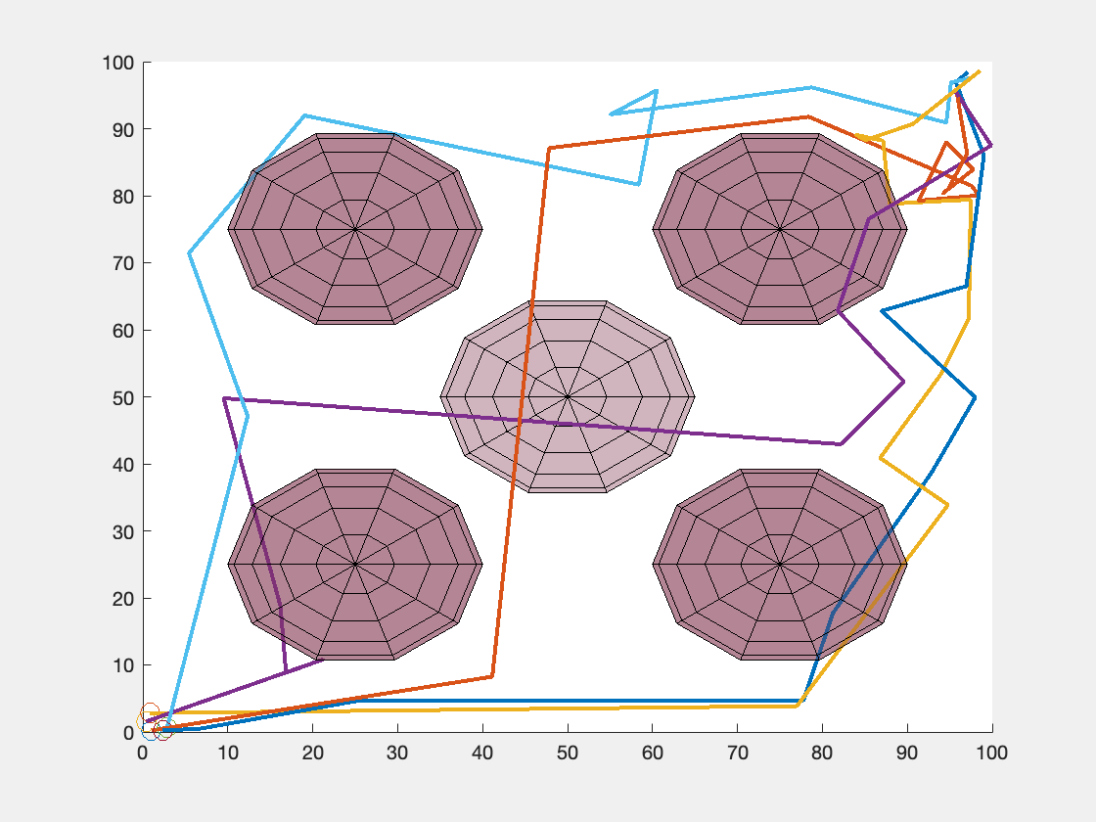
GIF from different angle

